Slide 1
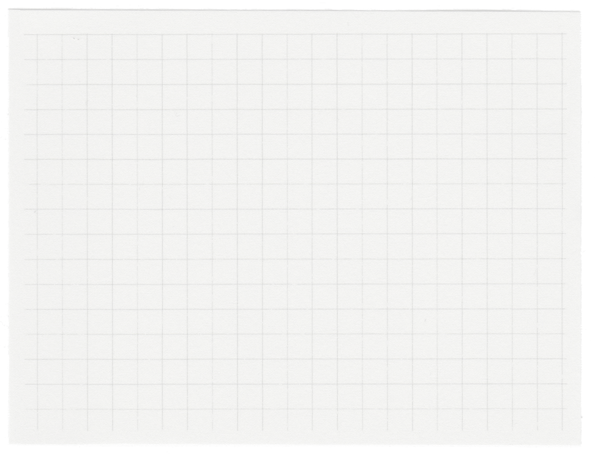














PART B: Student Segmentation
Name: Jon Sham
Class: DAAA/Ft/1B/06
Admin: P2317342

Slide 2

Background
Research
Clustering helps us identify distinct groups of students based on similarities in their characteristics or performance patterns. By grouping students into clusters, we can tailor interventions and support strategies more effectively, addressing the specific needs of each group. This allows educators to make data-driven decisions to improve educational outcomes for all students.

Slide 3
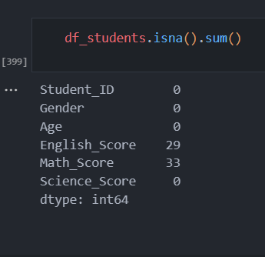
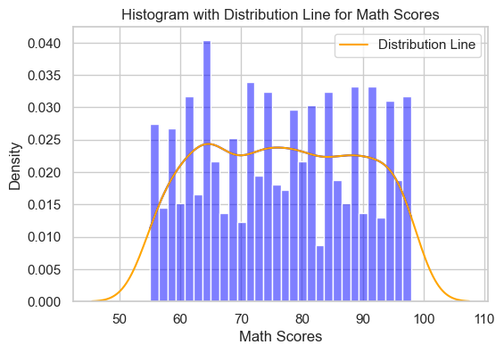
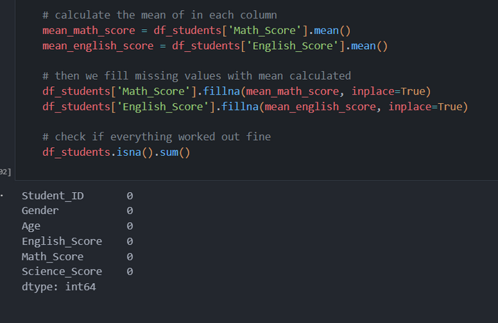
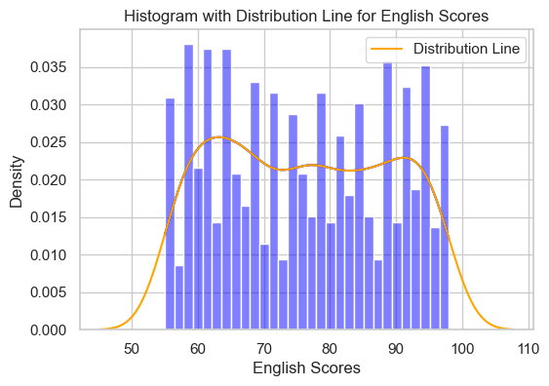
Handling Missing Values
Similarly, noting a symmetric distribution curve in the plot for math scores, it suggests a normal distribution. Consequently, I will opt for mean imputation for the missing values in the math scores column as well.
I utilize the isna() and sum() functions to identify and display the columns containing missing values.
Observing a relatively symmetric distribution line in the plot, indicative of a normal distribution, I plan to utilise the mean for imputing the missing values in the English scores column. Next let us check the plot for Math Scores.

Slide 4
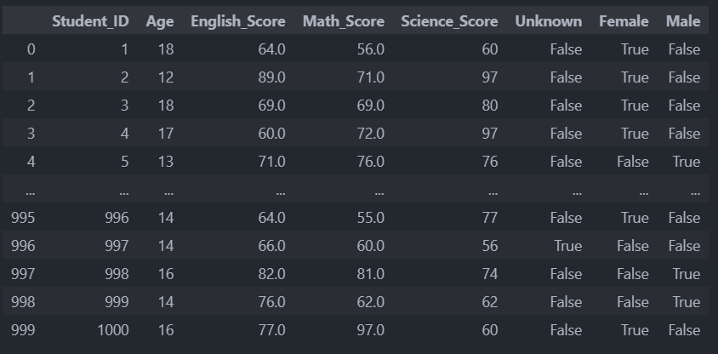
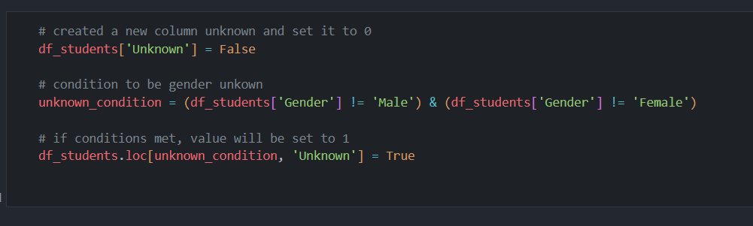
Encoding Variables and Feature Engineering
First, I plan to perform feature engineering by creating a new column named 'Unknown' and categorizing individuals with ambiguous gender into this column. I will implement a conditional statement to facilitate this categorization
Now, we will perform one-hot encoding using the get_dummies function from pandas

Slide 5
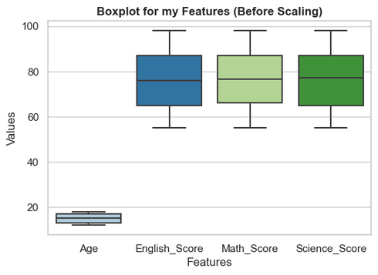
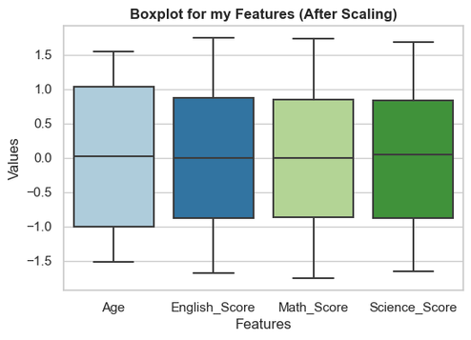
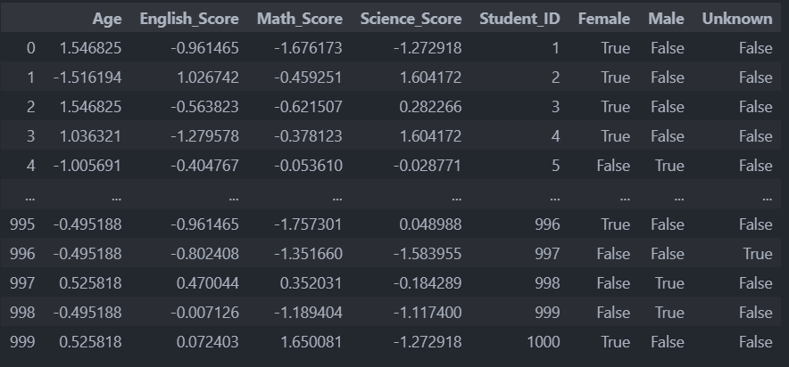
Feature Scaling
Now it's time for feature scaling, but before proceeding, I'd like to visualize the distribution and outliers of our data using boxplots
The substantial difference in the range of Age compared to English Score, Math Score, and Science Score may pose as a potential challenge for my model. Hence we need to scale as it is essential to prevent features with larger ranges from dominating the learning process. This ensures a balanced influence in all features
I won't scale the Student ID column because it represents unique identifiers for each student, and scaling it would not provide any meaningful interpretation. Similarly, I won't scale the Female, Male, and Unknown columns as they represent categorical variables I encoded through one-hot encoding. Scaling these columns could distort their binary nature, potentially affecting the model's performance
I will employ the StandardScaler from scikit-learn to scale these features

Slide 6
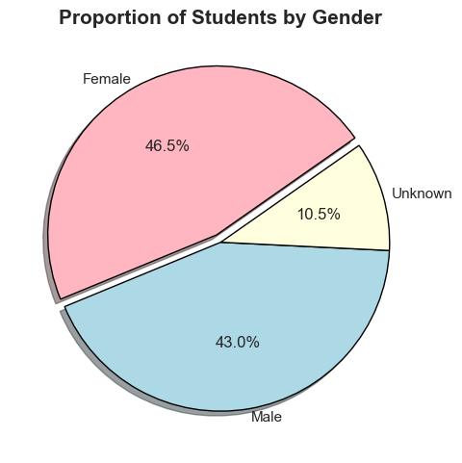
Visualizing Gender Proportions
Next, I will create a pie chart to visualize the proportions of students in each gender category. This visualization is crucial because gender may play a significant role in students' performance due to various factors such as societal expectations, access to resources, and learning styles. Understanding the gender distribution in the class allows us to assess potential gender imbalances and consider their impact on academic outcomes.
From the pie chart, it is evident that the highest proportion of students in the class is female

Slide 7
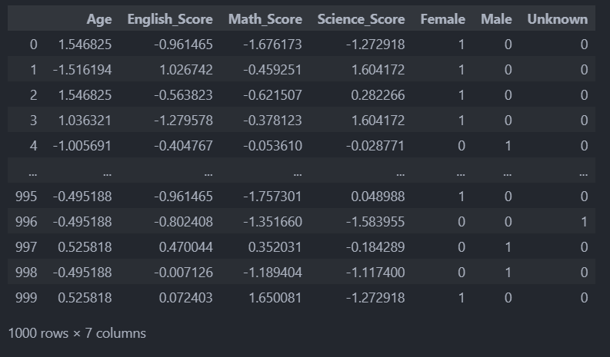
Dropping Irrelevant Columns
The next step in my data preprocessing is to drop the irrelevant column. Upon inspection, I have observed that the Student_ID column serves no additional purpose as the row index already serves as a unique identifier for each student. Therefore, I will proceed to drop the Student_ID column.
next i will be converting true/false values into boolean values represented as 1 or 0 for the gender categories

Slide 8
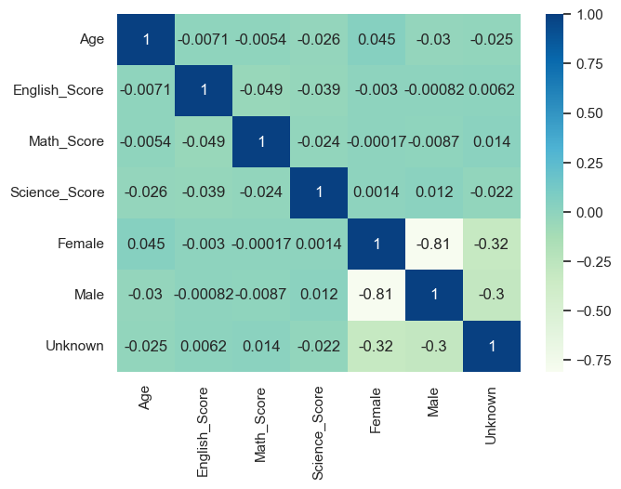
Correlation Visualization
From the correlation plot, it appears that there are no highly correlated features. This absence of strong correlations suggests that the features are relatively independent of each other, which can be beneficial for clustering model later on as it reduces the risk of redundancy in the data and simplifies interpretation

Slide 9
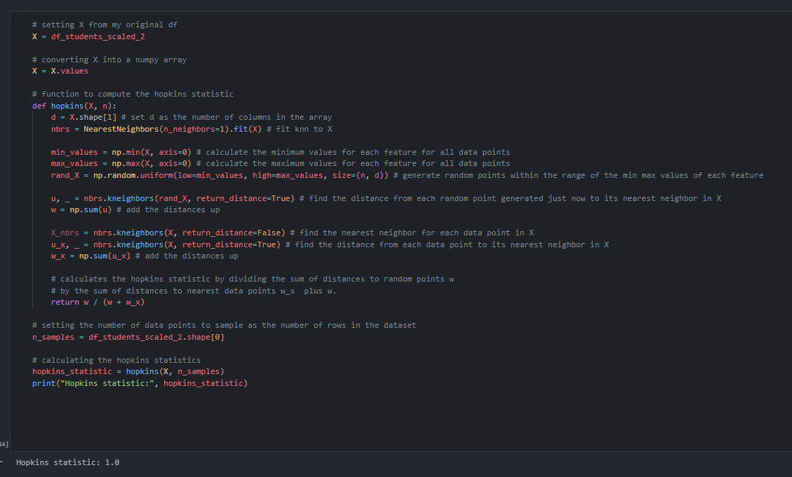
Hopkins Cluster Tendency
Next, I will use the Hopkins statistic to assess the clustering tendency of the dataset. A value close to 0 indicates that the data points are uniformly distributed, making clustering less feasible. Conversely, a value near 1 suggests that the data points are highly clustered, indicating a strong tendency for clustering.
Fantastic! We obtained a Hopkins statistic of 1, indicating a strong clustering tendency in the dataset. This suggests that the data points are highly clustered, which is great news for my model

Slide 10
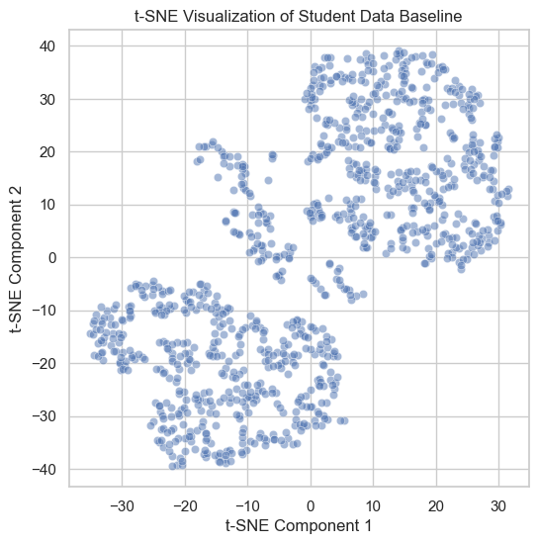
Dimension Reduction
Given the multidimensional nature of my dataset and the potential for complex relationships between features, applying t-SNE could help me gain a deeper understanding. t-SNE's lower-dimensional representation simplifies the visualization of complex relationships, patterns, and clusters, aiding in deeper exploration of the data
From this visualization, I observe three faint groupings in the data, indicating potential clusters. However, since t-SNE is a dimensionality reduction method used for visualization in this case, these clusters may not directly correspond to definitive clusters in the original high-dimensional space but hey, still a good way to visualize

Slide 11
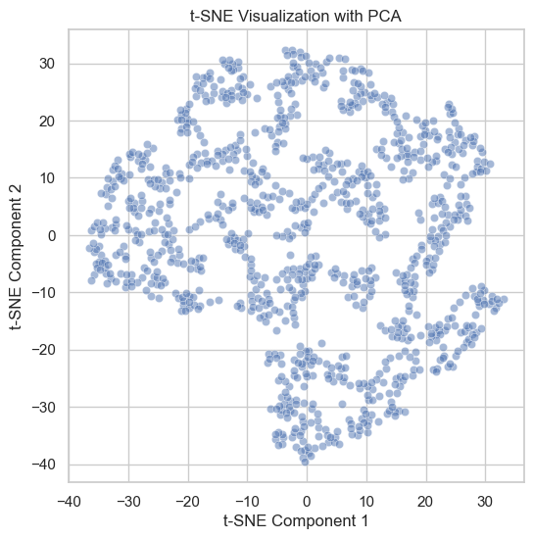
Dimension Reduction Pt. 2
To prevent my model from suffering from the curse of dimensionality, I will be using PCA for dimension reduction before applying the clustering algorithm. PCA will help reduce the dimensionality of the feature space while preserving as much variance as possible, making it more computationally efficient and less prone to overfitting. Additionally, PCA can help identify the most informative features for clustering, leading to better-defined clusters and improved model performance
After observing that before PCA, three faint clusters were forming, but after PCA, only one large cluster was observed, it suggests that PCA may have merged or obscured the underlying structure of the data. This outcome could be attributed to the loss of information because less informative dimensions were discarded. Considering the outcome where PCA merged distinct clusters into one large cluster, I've decided not to use it for dimension reduction as PCA's loss of information would negatively affect my model

Slide 12
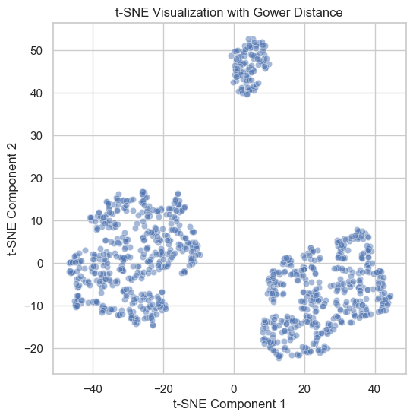
Dimension Reduction Pt. 3
In that case, I'll explore alternative dimension reduction methods like Gower. Unlike PCA, Gower's approach preserves information from various types of variables. This makes it better suited for heterogeneous datasets like mine, maintaining the richness and diversity of the original data for more accurate clustering
This is just excellent! What we can see are three distinct clusters emerging from the data. This is particularly advantageous for my clustering algorithm as distinct clusters indicate clear separability among data points. With well-defined clusters, the algorithm can more accurately assign data points to their respective groups, leading to more meaningful and interpretable results. Additionally, having distinct clusters suggests that the algorithm is effectively capturing the underlying structure of the data, enhancing its overall performance and utility for grouping the students into clusters.

Slide 13
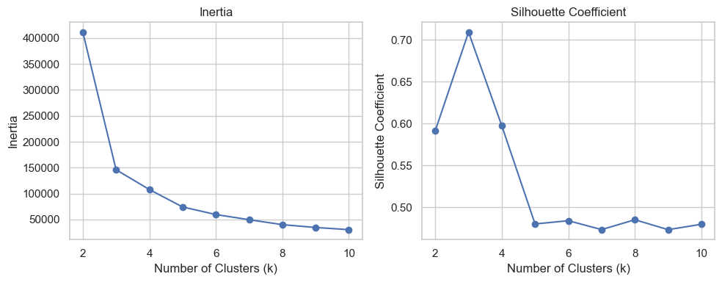
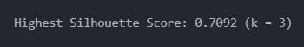
Silouhette Coefficient and Inertia
Next, I'll use the Silhouette Coefficient and Inertia to evaluate my clustering model. A higher Silhouette score suggests better cluster separation, while lower Inertia indicates more compact clusters. These metrics help assess the quality of the model and guide optimization decisions
From the plots, we observe that the Silhouette Coefficient peaked at 3 clusters, indicating optimal cluster separation. Similarly, the inertia plot exhibited the most significant drop at 3 clusters, suggesting well-defined clusters. Therefore, I will proceed with 3 clusters for my model

Slide 14
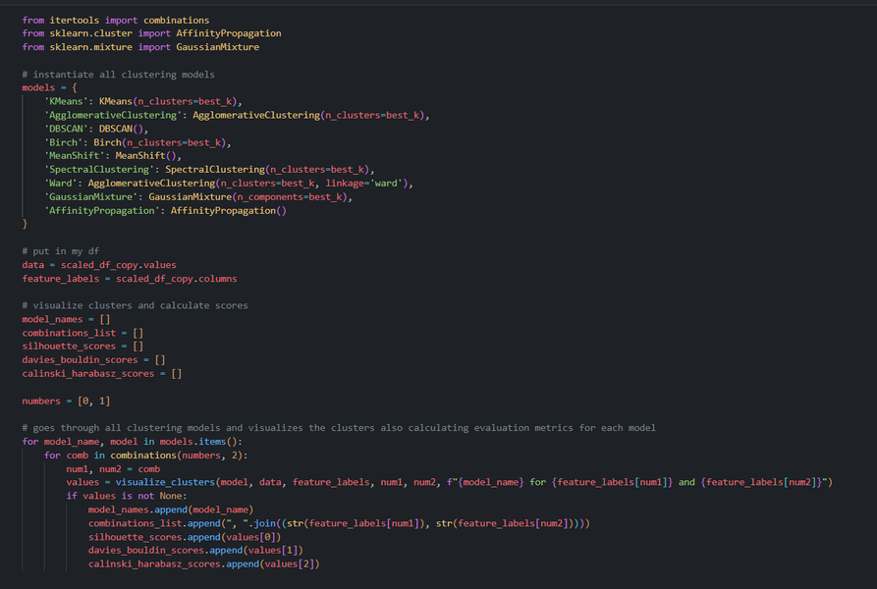
Modelling
Rough description of the metrics:
1. **Silhouette Score:**
- Measures the distance between clusters and the separation between different clusters.
- Ranges from -1 to 1, with higher values indicating better-defined clusters.
2. **Davies-Bouldin Index:**
- Measures the average similarity between each cluster and its most similar cluster.
- A lower value indicates better clustering quality.
3. **Calinski-Harabasz Index (Variance Ratio Criterion):**
- Measures the ratio of between-cluster variance to within-cluster variance.
- Higher values indicate better-defined clusters.
These metrics will help assess the quality and effectiveness of the clustering algorithms.
Next, I'll select the top few models based on the evaluation metrics. These models will be chosen based on their performance across the Silhouette Score, Davies-Bouldin Index, and Calinski-Harabasz Index

Slide 15
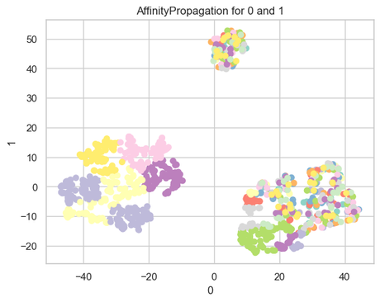
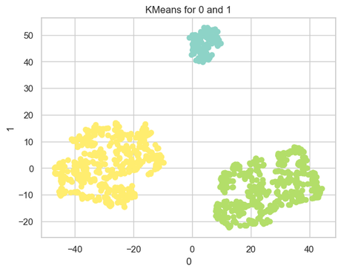
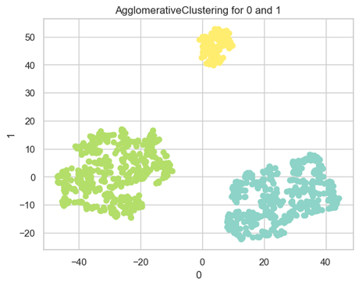
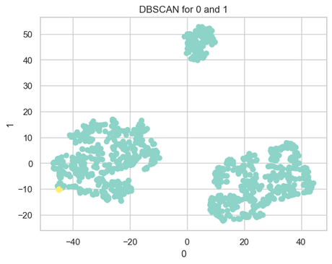
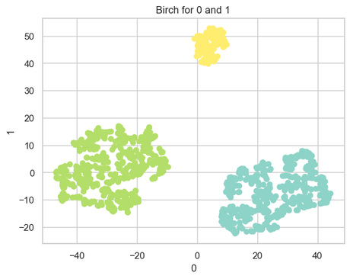
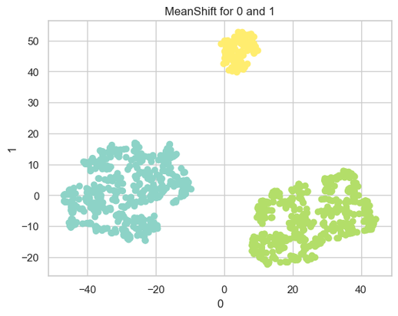
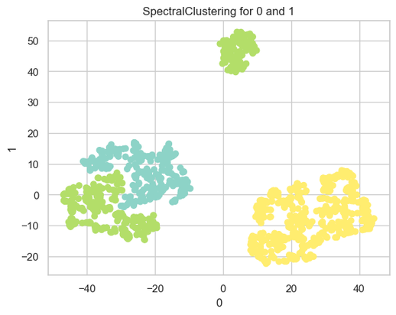

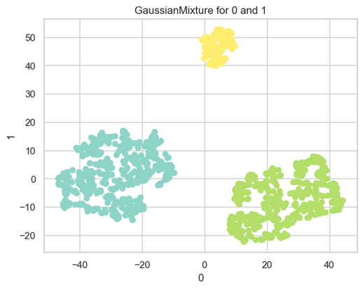
Modelling Pt. 2

Slide 16
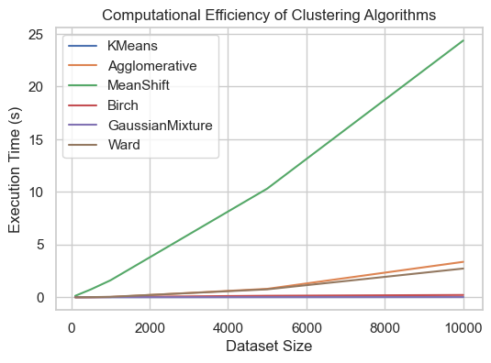
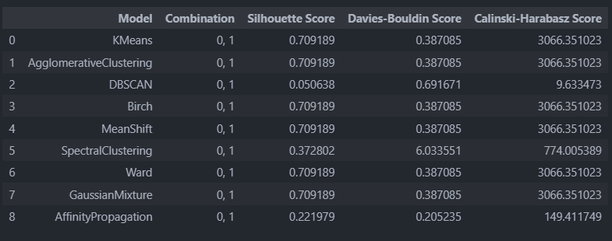
Choosing BestsModels
GaussianMixture, Ward, MeanShift, Birch, AgglomerativeClustering, and KMeans demonstrated the highest scores across all evaluation metrics. To make a more informed selection among these models, I can conduct further analysis such as comparing their computational efficiency
GaussianMixture, Ward, MeanShift, Birch, AgglomerativeClustering, and KMeans demonstrated the highest scores across all evaluation metrics. To make a more informed selection among these models, I can conduct further analysis such as comparing their computational efficiency
Since the plot indicates that as the dataset size increases, Meanshift, Ward and Agglomerative algorithms take longer to execute compared to the rest of the algorithms, we can conclude that they are not computationally efficient. Therefore, I won't select them to be used as my clustering algorithms

Slide 17
Hyper Tuning
Next, we proceed to hyperparameter tuning our model to enhance its performance further
I will use GridSearchCV to find the best parameters for optimizing my model
Tuning for KMeans
Tuning for Birch
Tuning for Gaussian Mixture

Slide 18
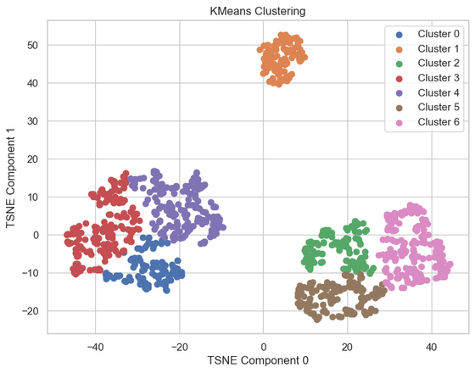
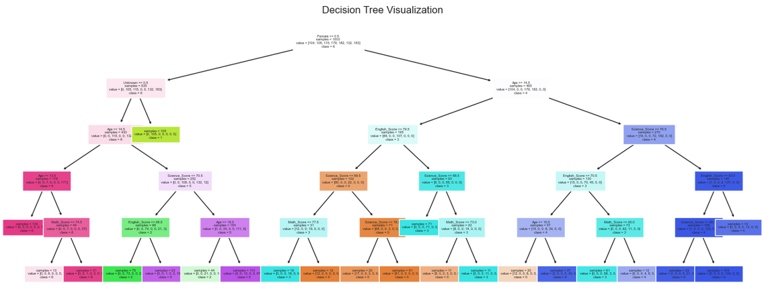
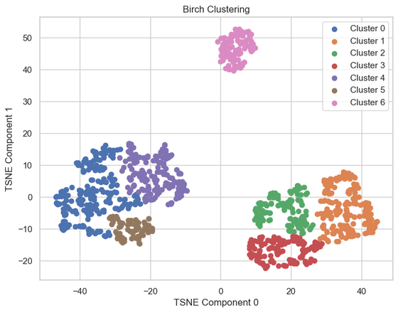
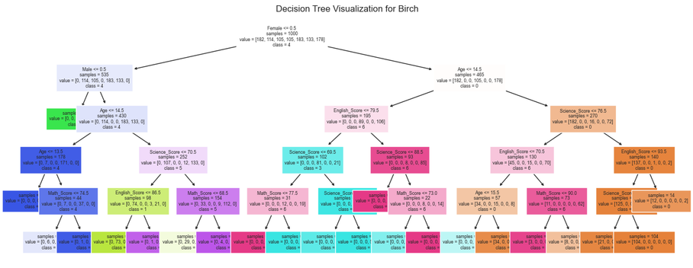
Interpretation
Now, we interpret the clusters from our models. Although the best value of k is 3 according to the inertia and silhouette plots, I've set the number of clusters to 7. This decision balances accuracy with interpretability, as I found that n_clusters = 7 offers the best interpretability for our analysis.
I will be using a decision tree to interpret the clusters. Decision trees provide a straightforward and interpretable representation of how clusters are formed by recursively partitioning the data based on feature values. By analyzing the tree, we can identify the most important features and their thresholds for splitting the data into different clusters
For KMeans
For Birch

Slide 19
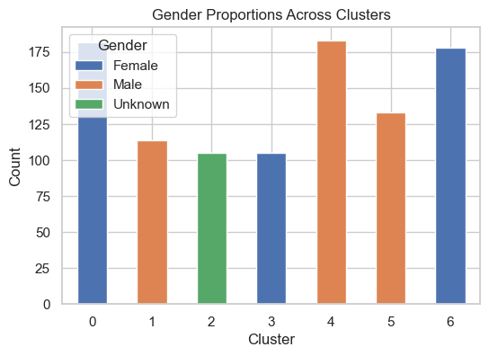
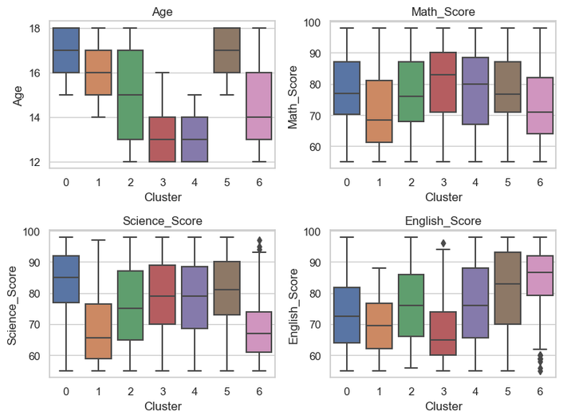
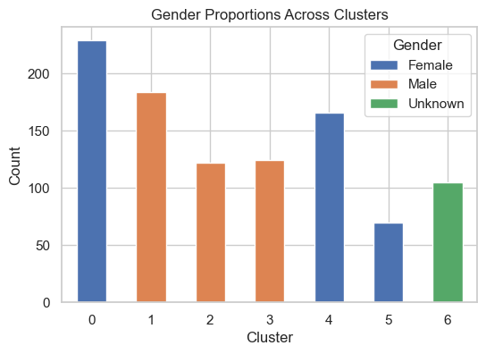
Visualizing
Results
For KMeans
For Birtch

Slide 20
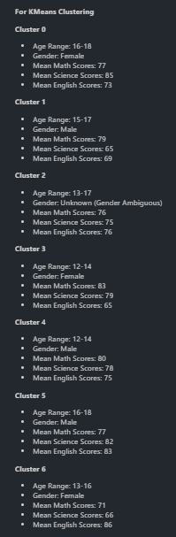
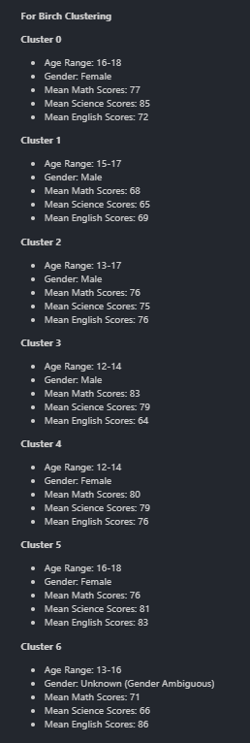
Conclusion
For the KMeans clustering, the group of students that may require the most assistance would be cluster 1. Similarly, for Birch clustering, it would be cluster 1. This assessment is based on the observation that the mean scores for cluster 1 are comparatively lower than those of the other clusters. Hence, identifying these clusters allows for targeted interventions and support strategies to address the specific needs of these students

